Slide 1
Angular – High level overview

Slide 2
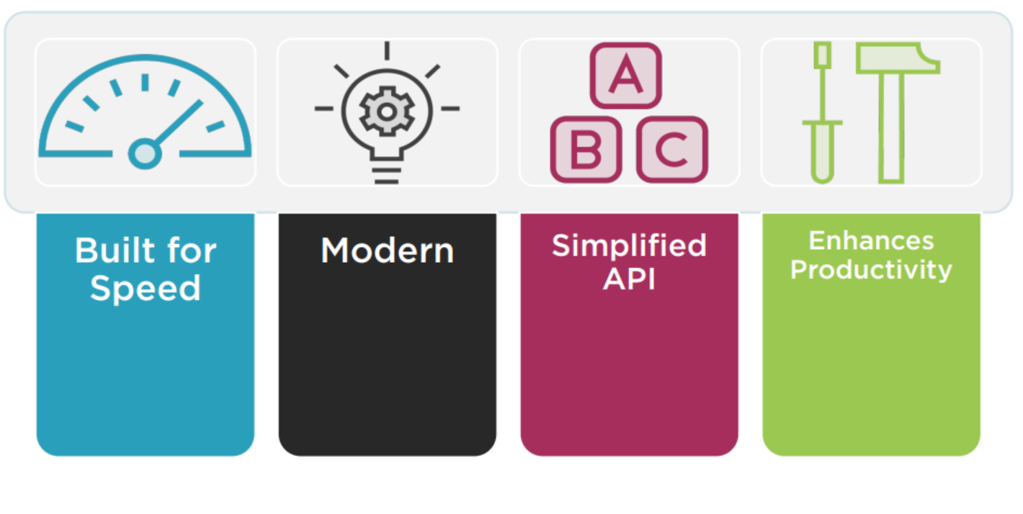
Why a New Angular?

Slide 3
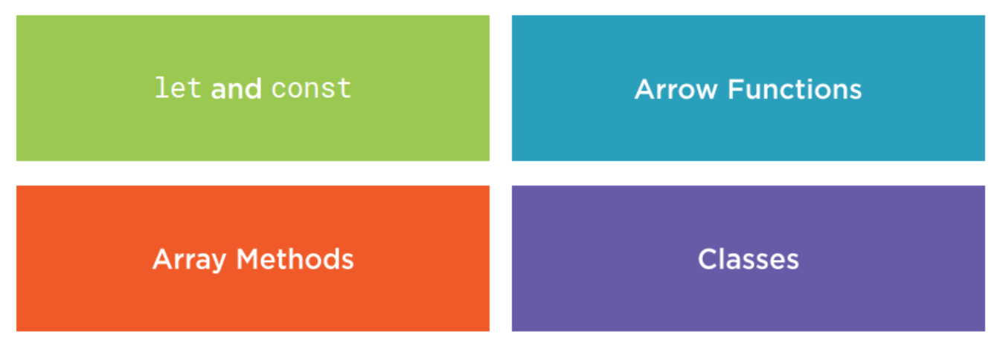
ES2015 (formerly known as ES6)

Slide 4
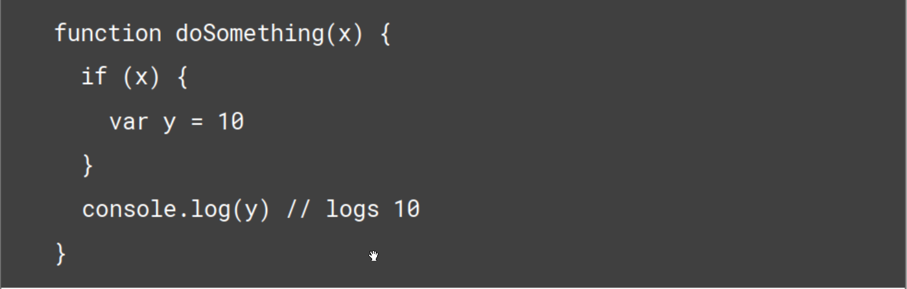
let and const

Slide 5
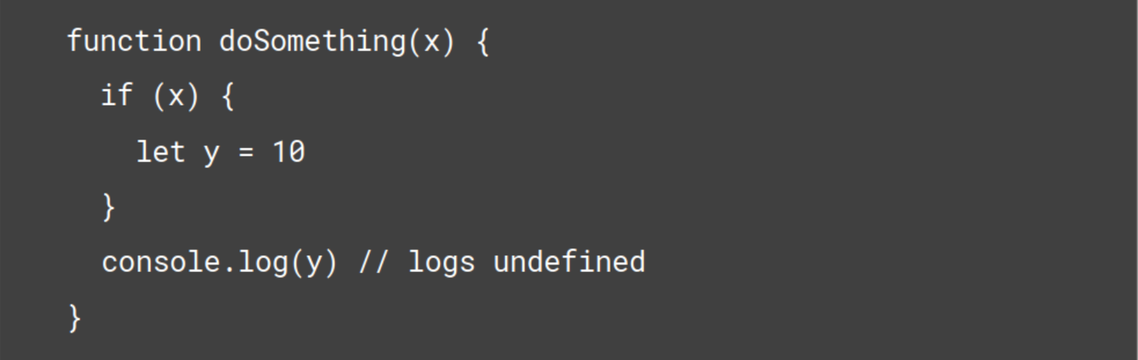
let and const

Slide 6
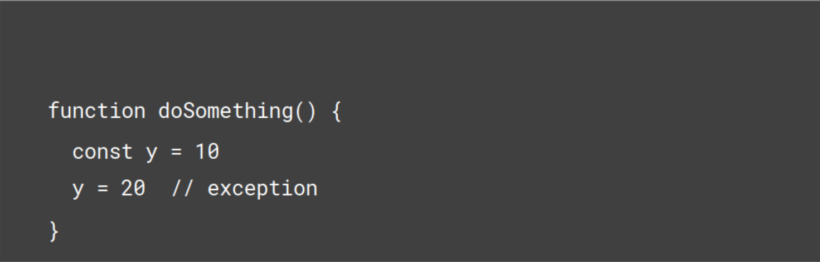
let and const

Slide 7
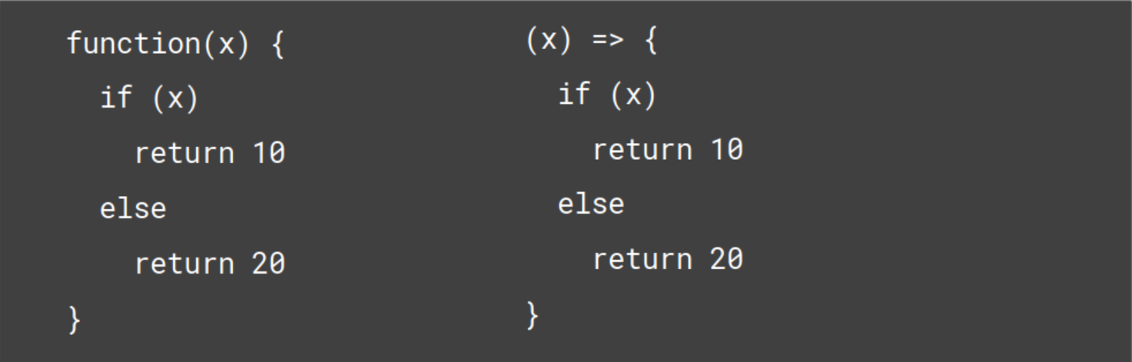
Arrow Function

Slide 8
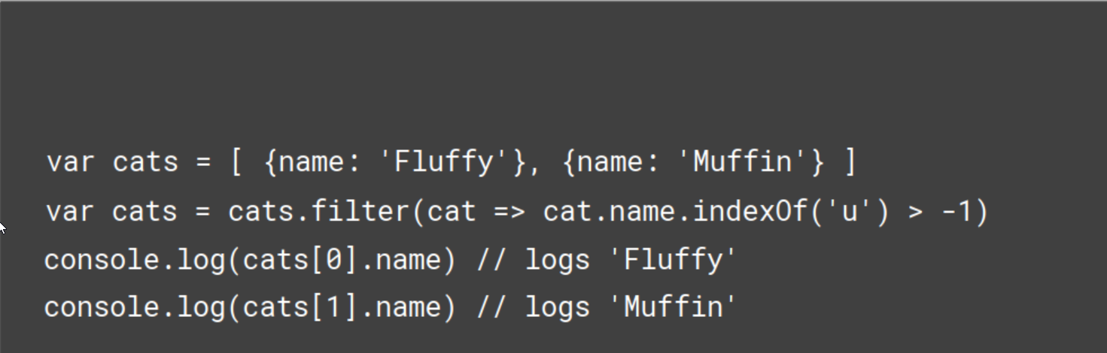
Array methods
Notes:
Many new methods to collection have been introduced in ES6

Slide 9
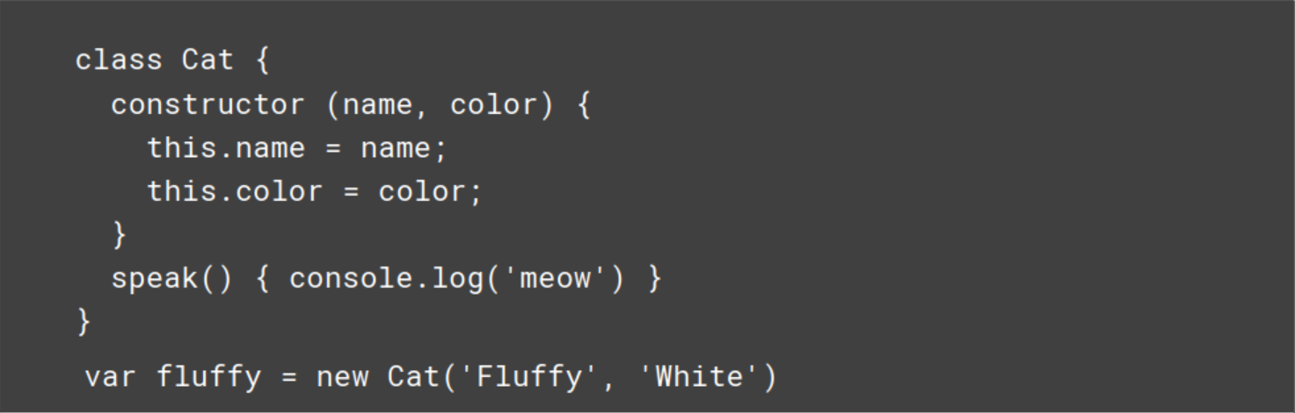
Classes

Slide 10
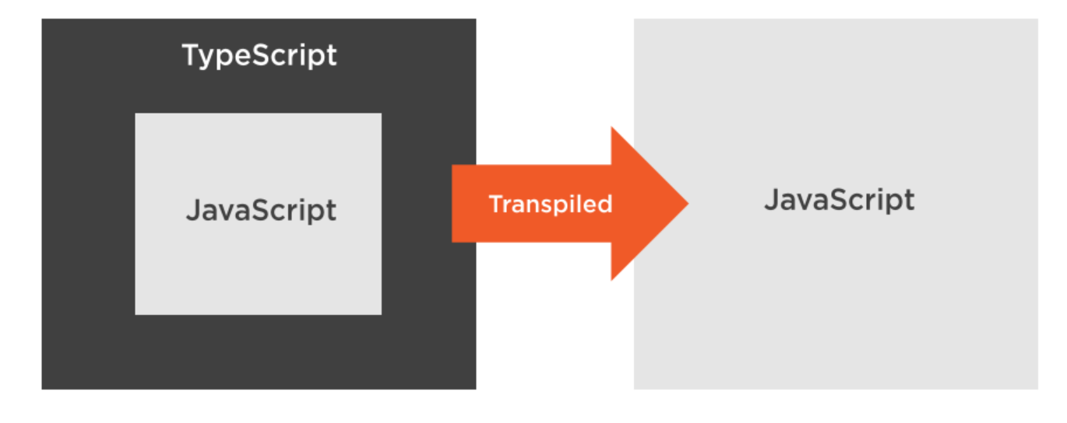
TypeScript

Slide 11
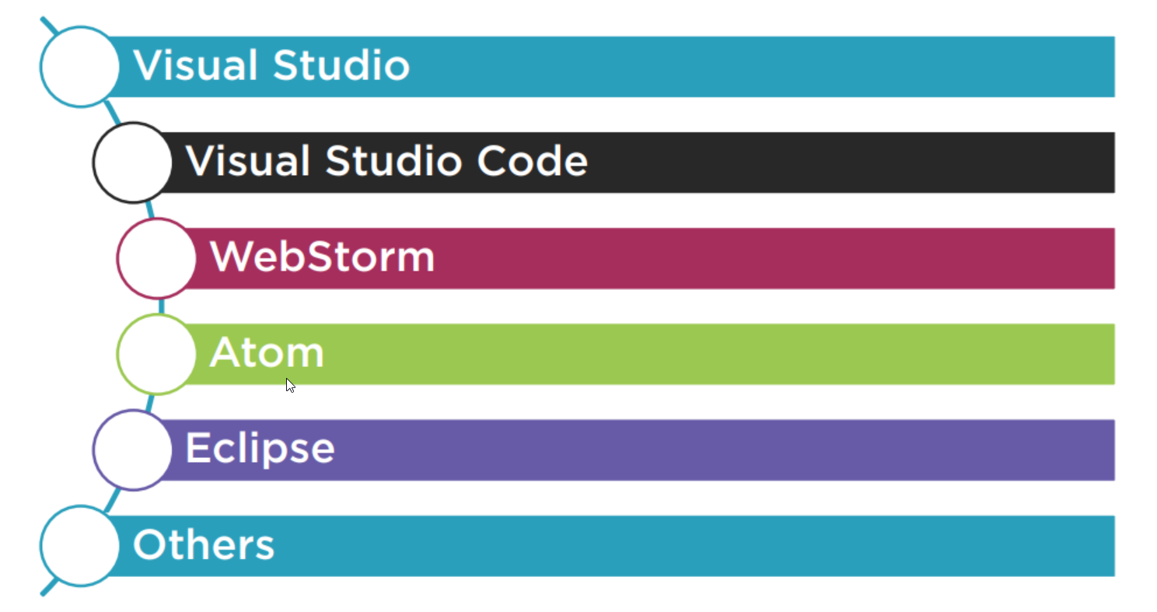
TypeScript Editors

Slide 12
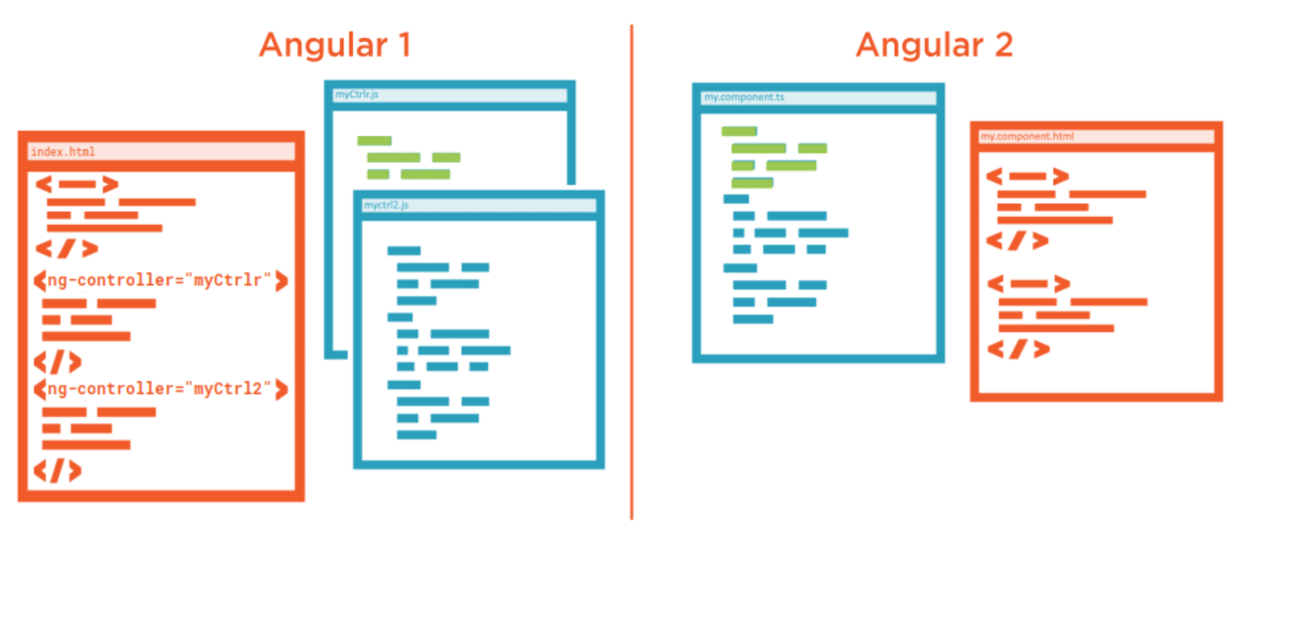
MVC vs Components

Slide 13
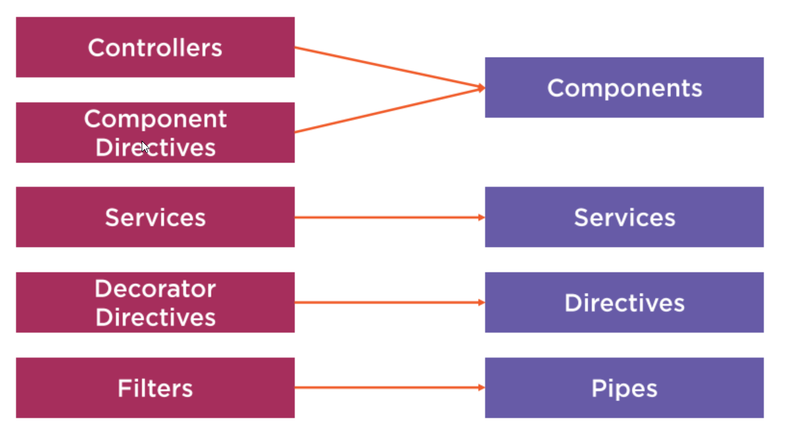
Angular 1 to 2 Mapping

Slide 14
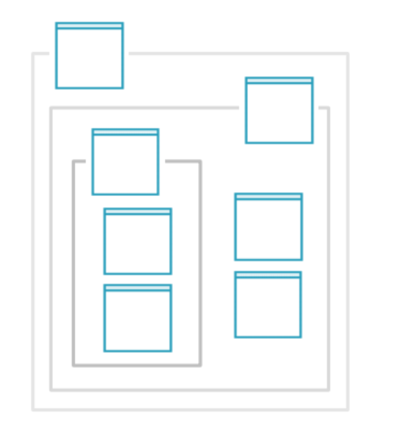
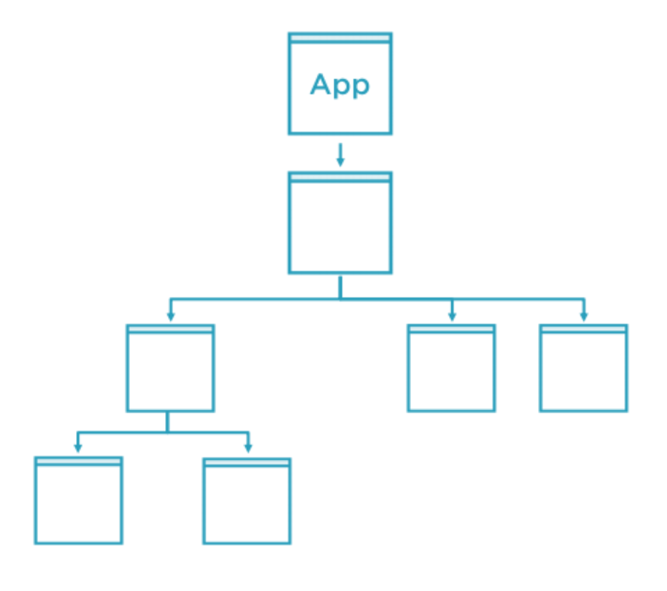
Component Hierarchy

Slide 15
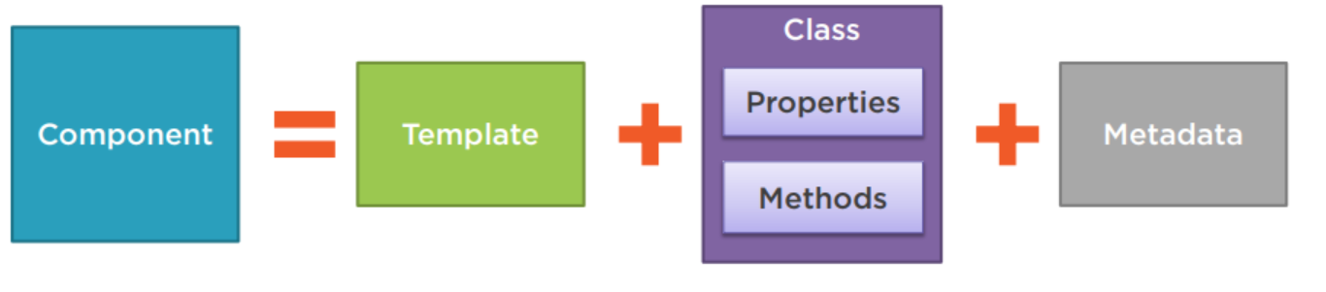
Component

Slide 16
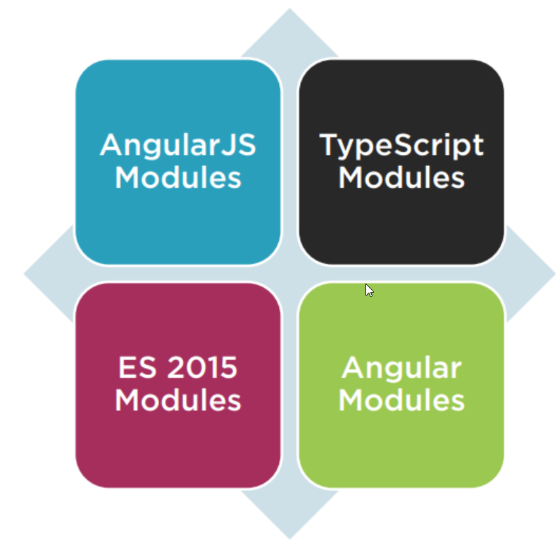
Modules
Code Organization
Namespaces

Slide 17
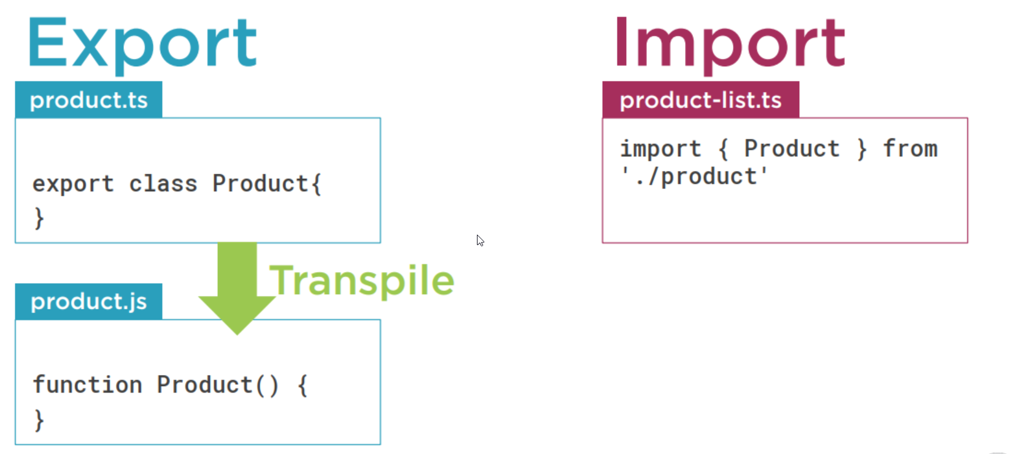
ES 2015 Modules

Slide 18
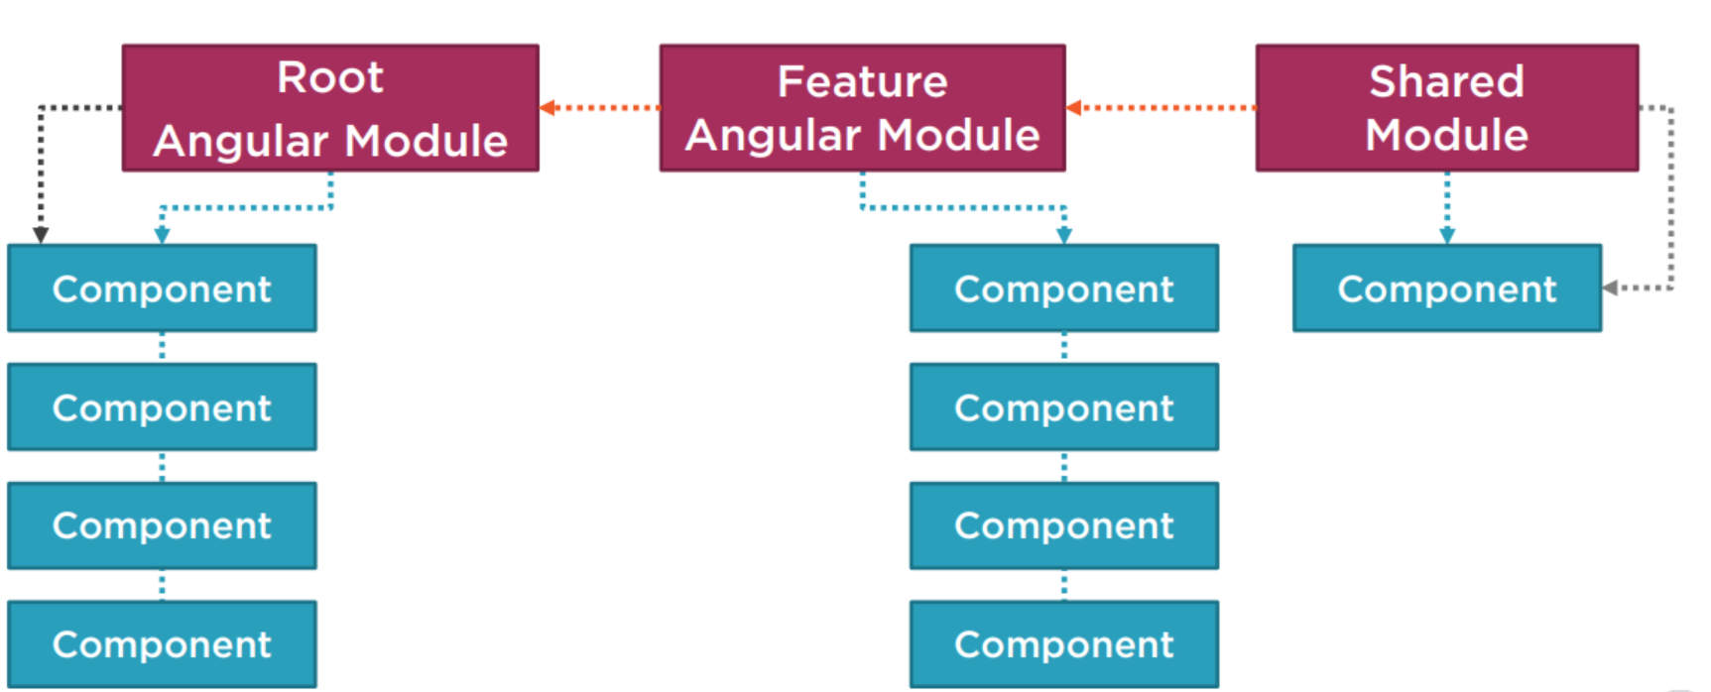
Angular Modules

Slide 19
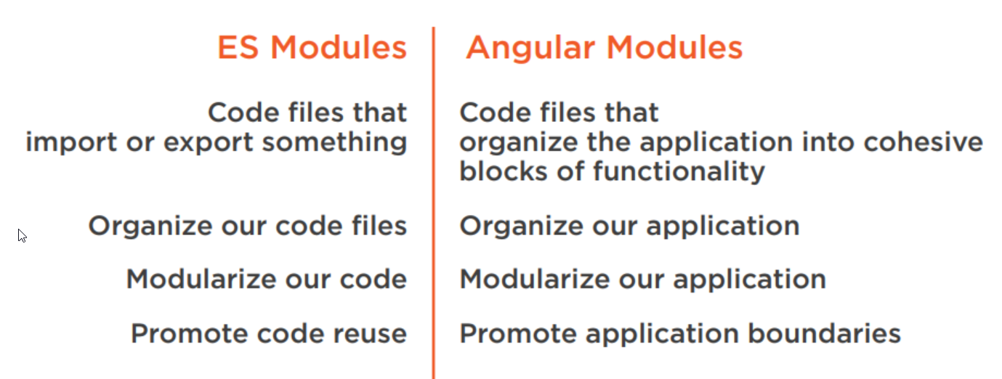
Modules – in summary

Slide 20
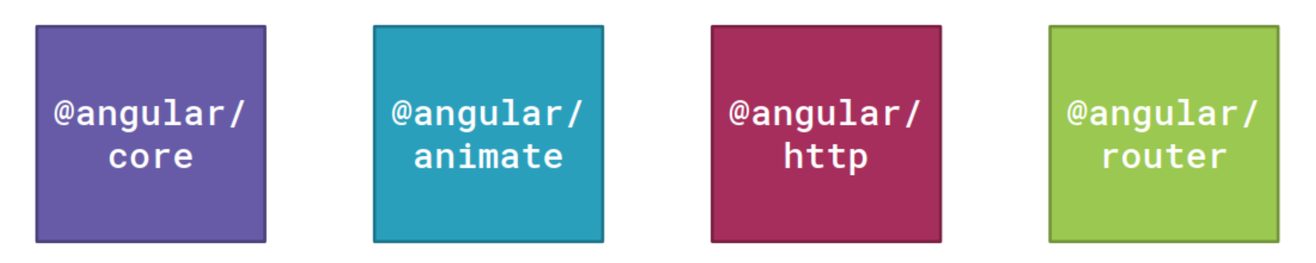
Angular Is Modular

Slide 21
Binding
Coordinates communication between the component's class and its template and often involves passing data.

Slide 22
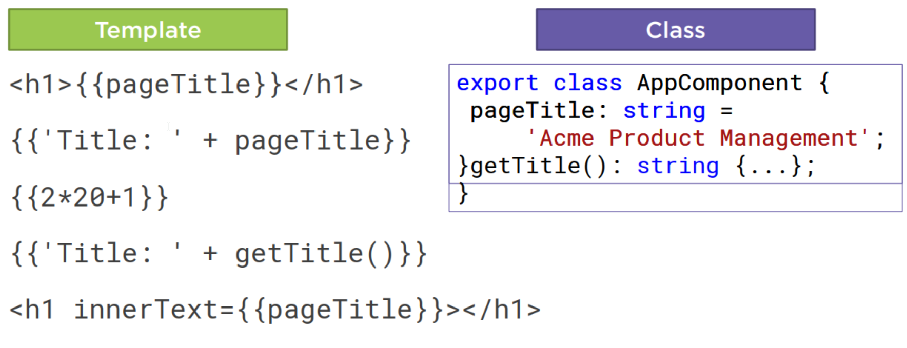
Interpolation

Slide 23
Directive
Directives are markers on a DOM element (such as an attribute) that tell Angular to attach a specified behavior to an existing element.
Custom HTML element or attribute used to power up and extend our HTML.
Custom
Build-in

Slide 24
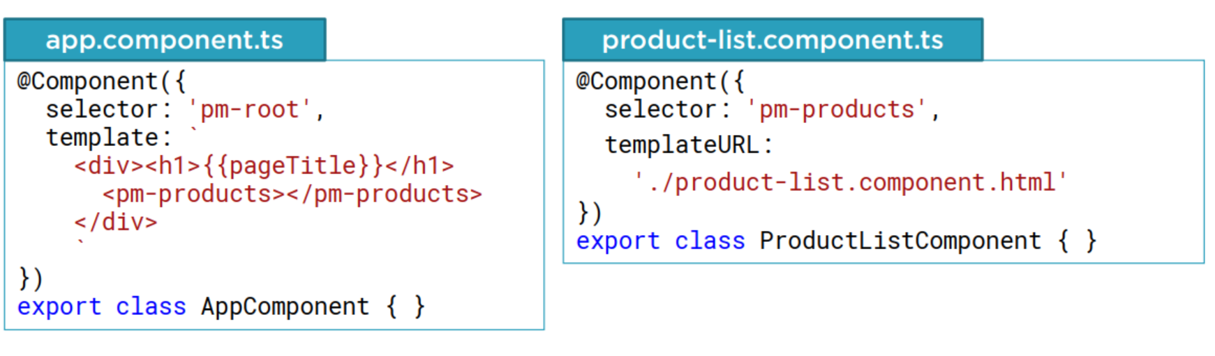
Custom Directives

Slide 25

Angular Built-in Directives

Slide 26
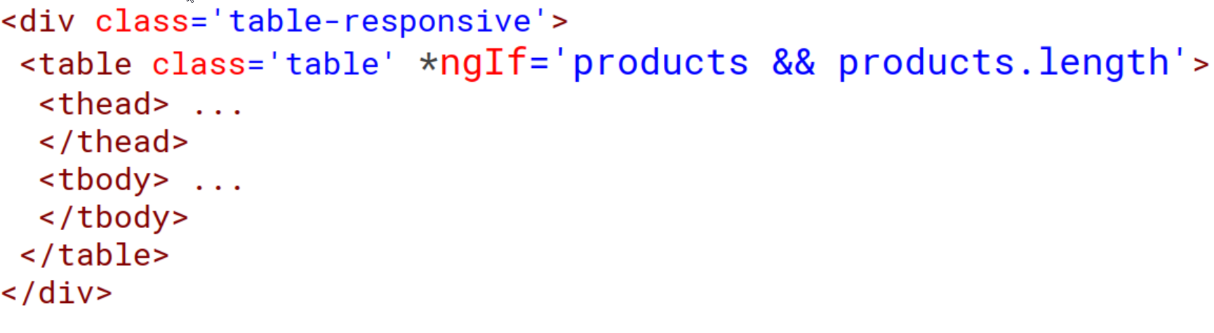
*ngIf Built-In Directive

Slide 27
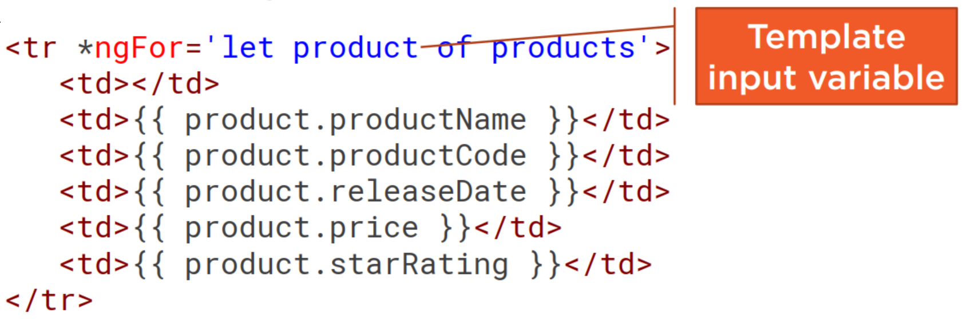
*ngFor Built-In Directive

Slide 28
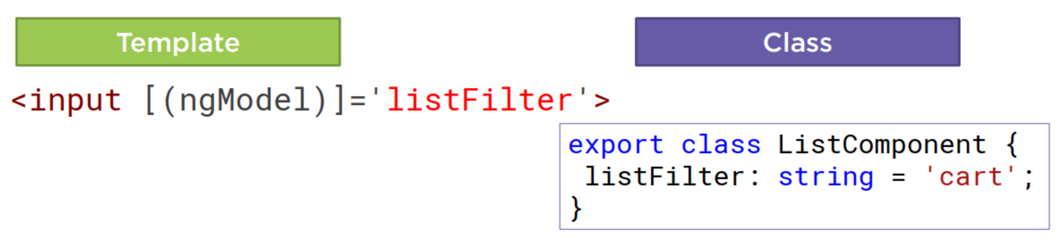
Two-way Binding

Slide 29
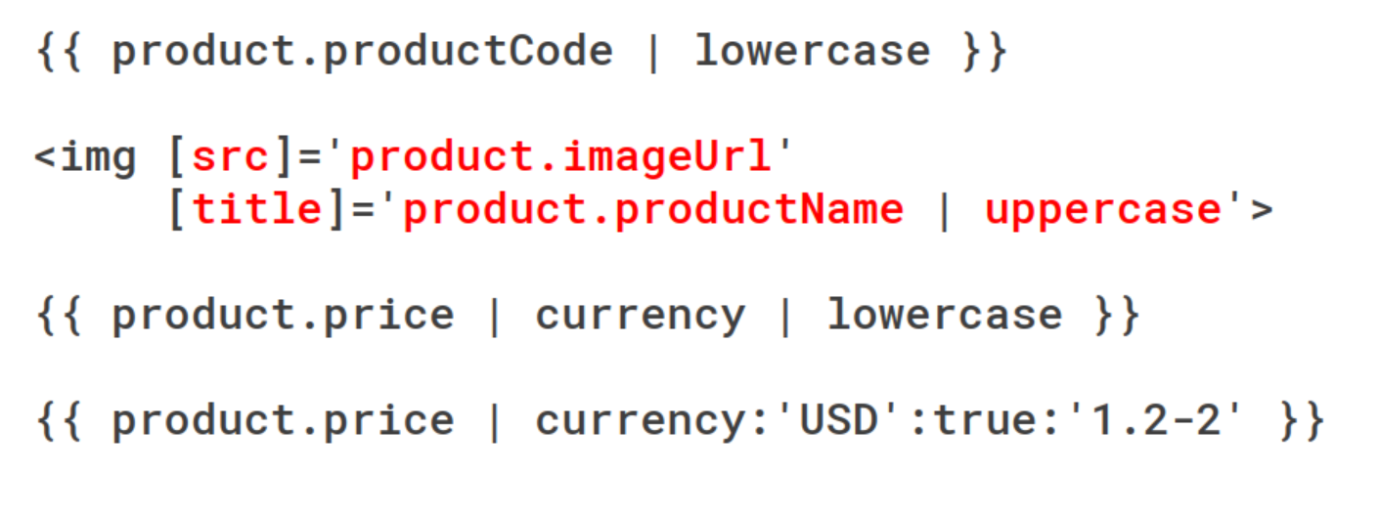
Transforming Data with Pipes

Slide 30
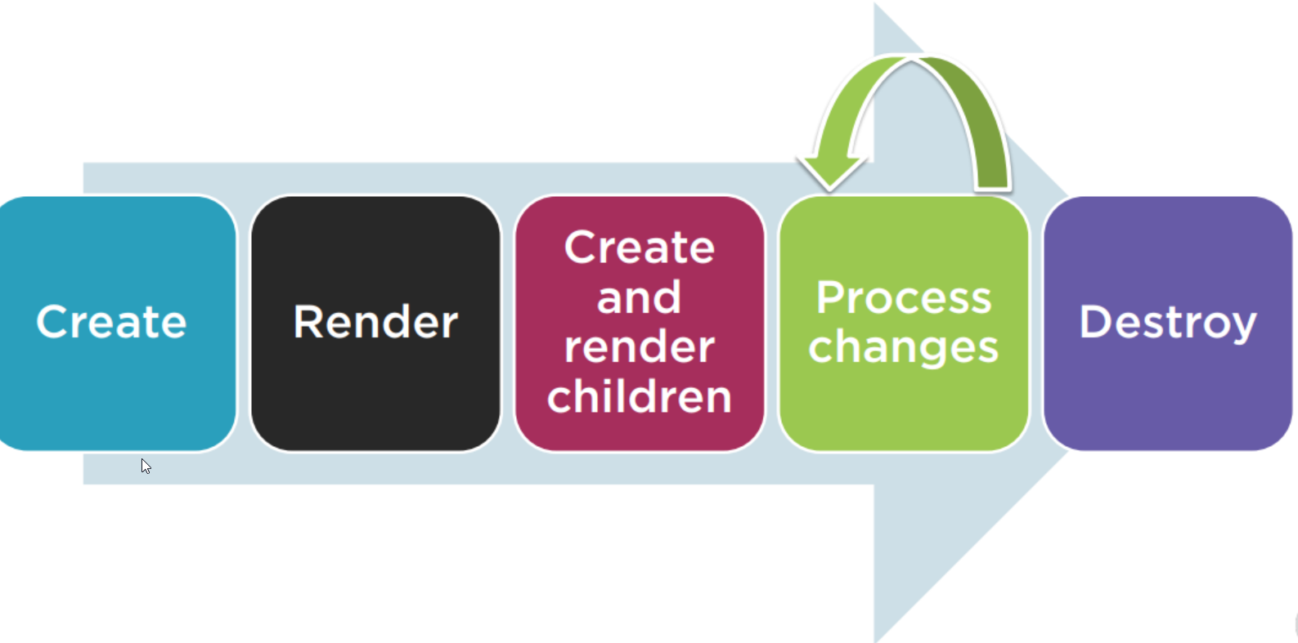
Component Lifecycle

Slide 31
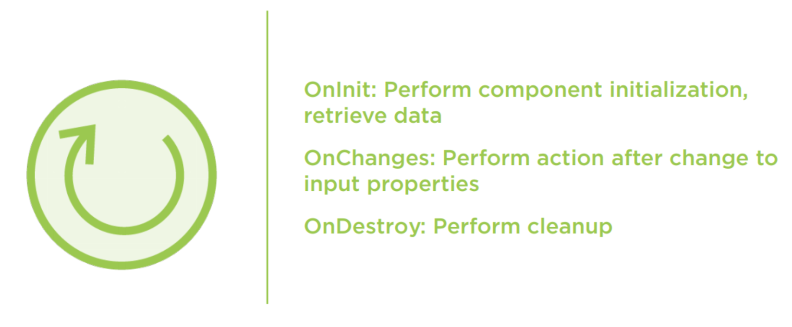
Component Lifecycle Hooks

Slide 32
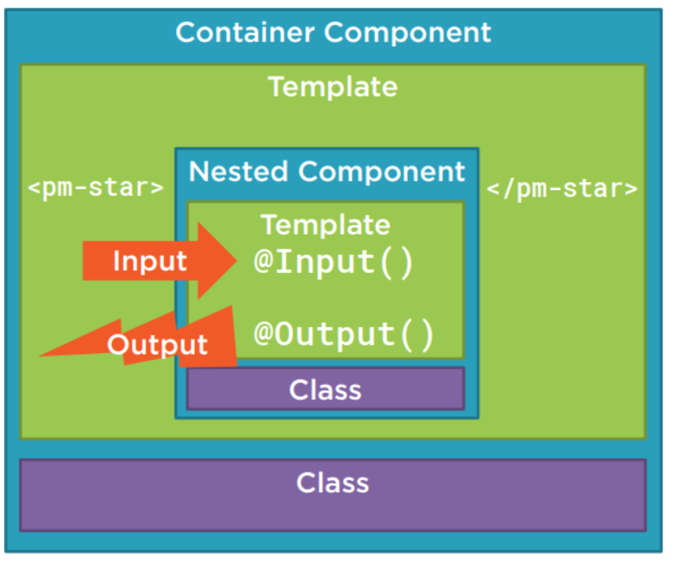
Nested Component

Slide 33
Dependency Injection
A coding pattern in which a class receives the instances of objects it needs (called dependencies) from an external source rather than creating them itself.

Slide 34
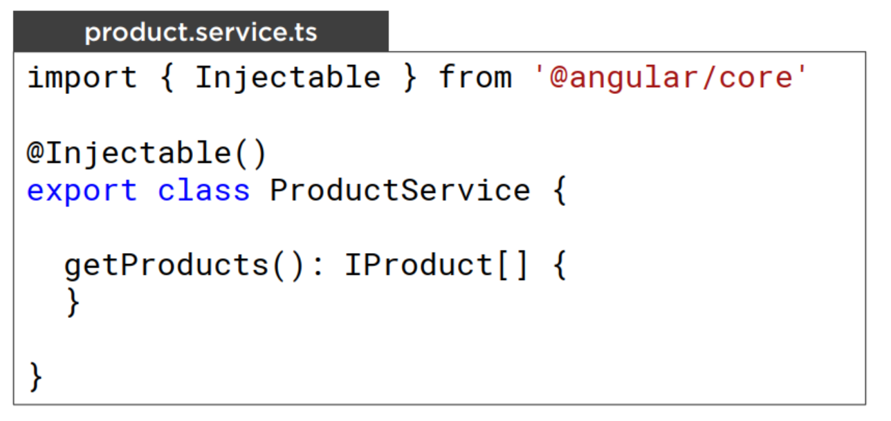
Building a Service

Slide 35
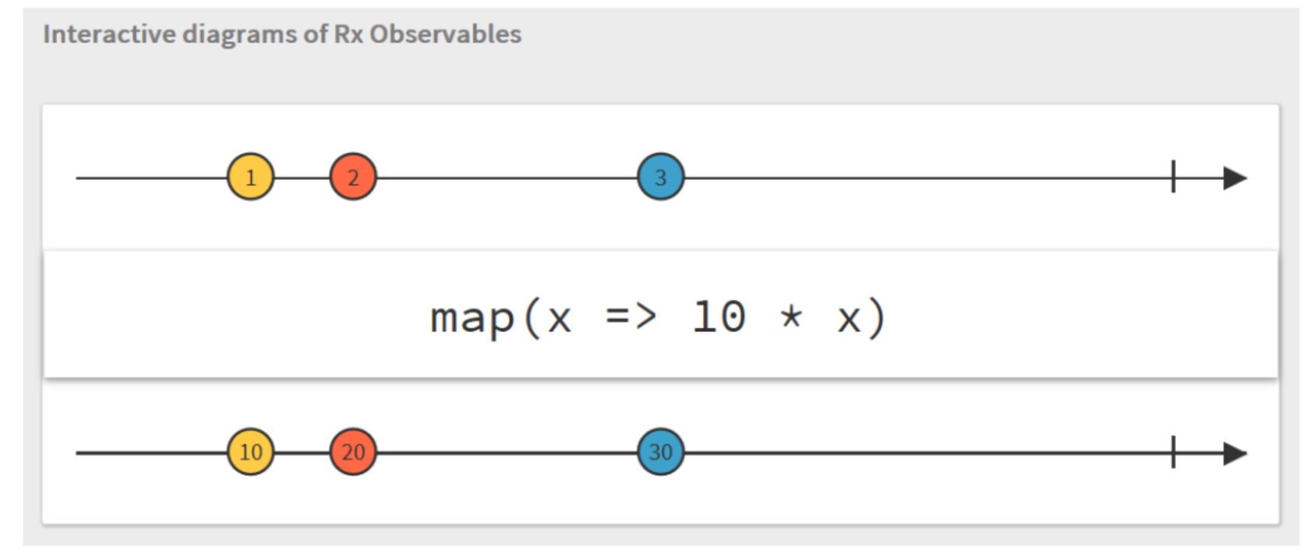
Observables

Slide 36
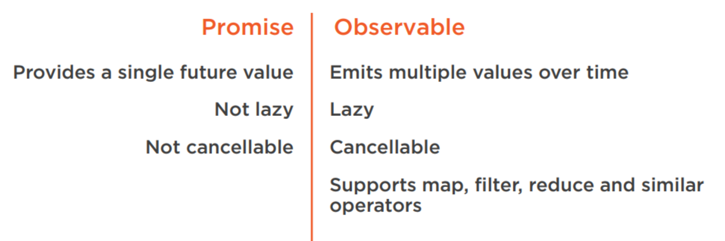
Promise vs Observable
Notes:
https://medium.com/@mpodlasin/promises-vs-observables-4c123c51fe13

Slide 37
Installing the Angular CLI
npm install -g @angular/cli

Slide 38
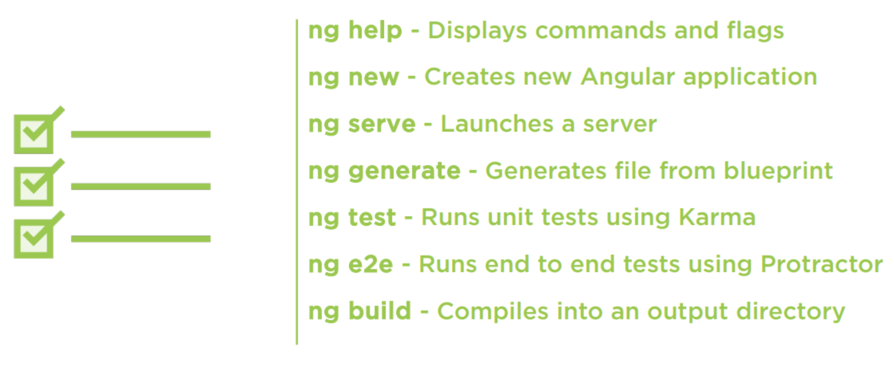
Angular CLI Checklist: Commands

Slide 39


Further reading

